Slide 1
2024 Medicaid Statewide Provider Training
Claims and Billing
Notes:
This is a template. Please make a copy/duplicate of the template before editing.

Slide 2
Agenda
Housekeeping items
EDI
Medical notes and hearing guidelines
Claims inquiry
Adding Third Party Liability
and Coordination of Benefits
Claim submission options
Publications
Office of Medicaid Operations

Slide 3
Housekeeping items

Slide 4
Office of Inspector General
Utah Medicaid will turn providers over to the Office of Inspector General (OIG) for not abiding by the terms set forth in the Provider Agreement. Including, but not limited to: members being sent to collections or balance billed for services.

Slide 5
The False Claims Act
Federal: § § 3729-3733] prohibits individuals or entities from submitting inaccurate claims to a government payer (i.e., Medicare, Medicaid). Entities can violate this law by knowingly presenting a false or fraudulent claim to one of these programs or causing a false claim to be presented.
Utah State: A person may not enter into an agreement, combination, or conspiracy to defraud the state by obtaining or aiding another to obtain the payment or allowance of a false, fictitious, or fraudulent claim for a medical benefit. 26B-3-1106 False claims for medical benefits prohibited.
Examples of potential false claims include, but are not limited to: (a) billing of items or services that were never rendered by the health care provider; (b) billing for services that are medically unnecessary; (c) upcoding (practice of billing for Medicare/Medicaid using a billing code providing a higher payment rate than the billing code intended to be used for the service or item furnished to the patient); (d) billing separately for services that should be bundled; (e) billing separately for outpatient services that were provided within 72 hours (before or after) an inpatient stay; (f) billing for a discharge in lieu of a transfer.

Slide 6
EDI

Slide 7
PRISM paper remittance advice
To find a Paper RA search for it in the My Inbox in PRISM using the Filter by ‘Description’ and ‘Paper RA’ as the search term. This will bring up all remittances from go-live April 2023.
A credit balance occurs when there are takebacks or if we make an advanced payment to the provider. The credit balance will carry onto the next remittance if there are not enough paid claims to apply to that credit balance.
The credit balance no longer carries over for two weeks before it starts to clear (drop off), it is now being applied in that current remittance. This change took effect as of August 14, 2023.
On the Paper RA, the Adjustment Type for the credit balance amount was changed from ‘Balance Owed by Tax ID’ to ‘Invoice’. The amount applied to the credit balance will be found on the AP/AR Netting line under Adjustment Amount.

Slide 8
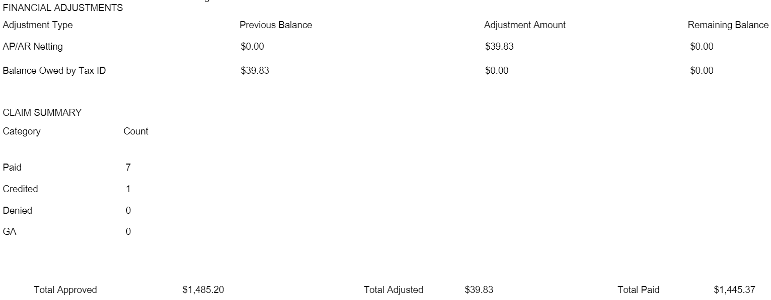
Example of credit balance with adjustment amount on a paper remittance advice
The above example shows that there was a previous credit balance of $39.83 and that there were enough paid claims on this remittance to clear that credit balance (adjustment amount $39.83). The adjustment amount listed in the Total Adjusted field is subtracted from the Total Approved amount and then the remaining amount in the Total Paid field is what was actually paid to the provider.

Slide 9
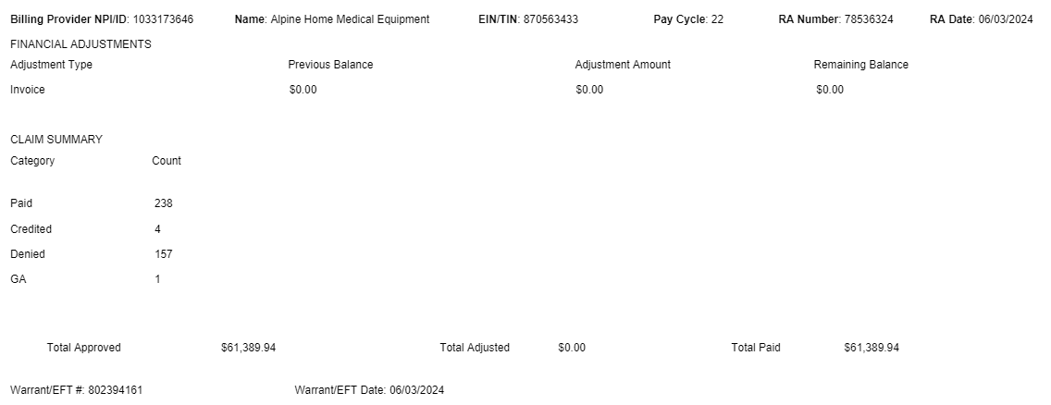
Example of no credit balance on paper remittance advice with a gross adjustment (GA)
**All paid and denied claims (except for pharmacy claims) will have the Remark Code of N1. This code provides information about hearing rights and is not a denial.
The descriptions of the CARC and RARC codes will not be given on the paper RA or the 835. Providers will need to look up these codes to find out the meaning of that code. To view the descriptions, providers can view the Claim Denial Codes List (CARC_RARC) document on the website https://medicaid.utah.gov/claims/ or go to https://x12.org/codes to view all x12 codes.

Slide 10
How do I verify my Trading Partner Number (TPN) that is receiving my electronic remittance advice (835)?
Provider may verify what TPN they chose to receive their electronic remittance advice (835) by going to the Business Process Wizard (BPW) and verifying the Billing Agent (1) they chose along with the Mode of Claim submission (2) they intend to use for claims and other medical billing x12 files.
  Associate Billing Agent
  Mode of Claim Submission/EDI Exchange
  835/ERA Enrollment Form

Slide 11
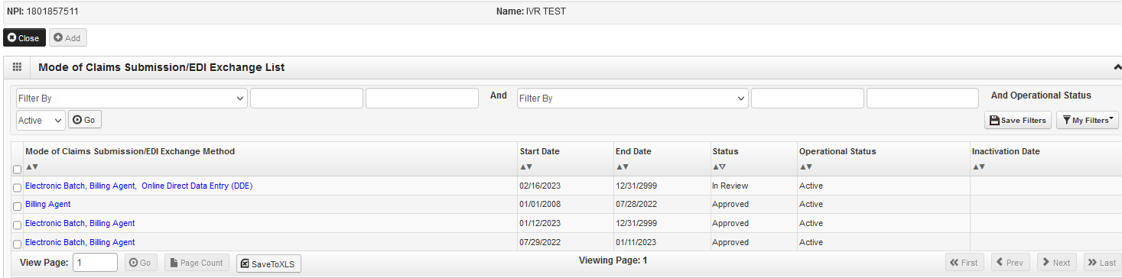
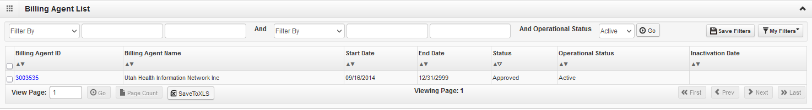
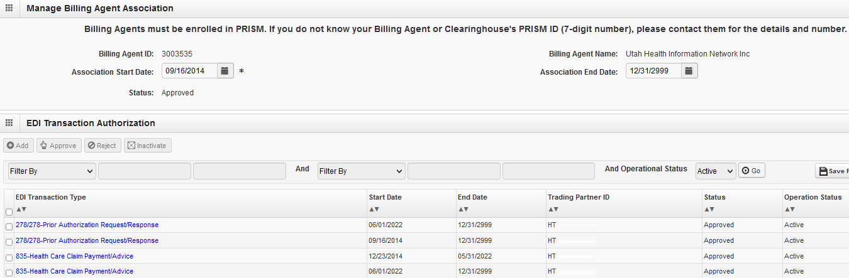

Slide 12
How to view paper remittance advice
Providers may view Paper RA (paper remittance advice) by logging into PRISM. Providers must log in with a profile that has access to the archived documents area in PRISM, including the following:
Claims Submitter – Provider
Claims Inquiry – Provider
Claims Processor – Provider
EDI Analyst
Once logged into the correct profile, providers will open their My Inbox link to click on the Archived Documents link which opens a search to put in the search criteria to find the specific remittance they want to review.

Slide 13
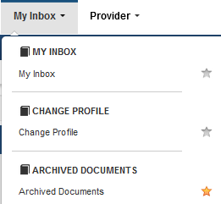
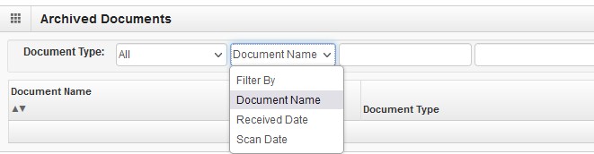
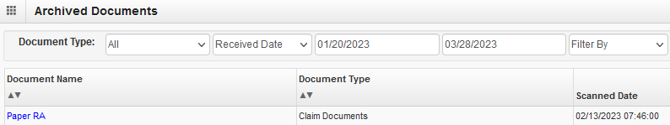
Providers may search by Document Name, Receive Date, or Scan Date.
Once located, click on the blue hyperlink Paper RA to open the pdf in their default viewer.

Slide 14
Understanding the EDI enrollment steps
Step 8: Select what transactions to exchange with Utah Medicaid.
Step 9: Associate Trading Partner Number (TPN) from Billing Agent/Clearinghouse.
  This is not the same as a Payer ID that is typically 5 to 7 characters that a provider adds to their provider information inside of their practice management software to route the claims to Utah Medicaid.
  The TPN is formatted as follows: HTxxxxxx-xxx.
  Providers must know the TPN to enroll to send claims electronically.
  More information for the provider’s Billing Agent/Clearinghouse can be found in the companion guides located on the Utah Medicaid website: https://medicaid.utah.gov/claims/
Step 13: Select how you would like to receive a remittance information from Utah Medicaid.

Slide 15
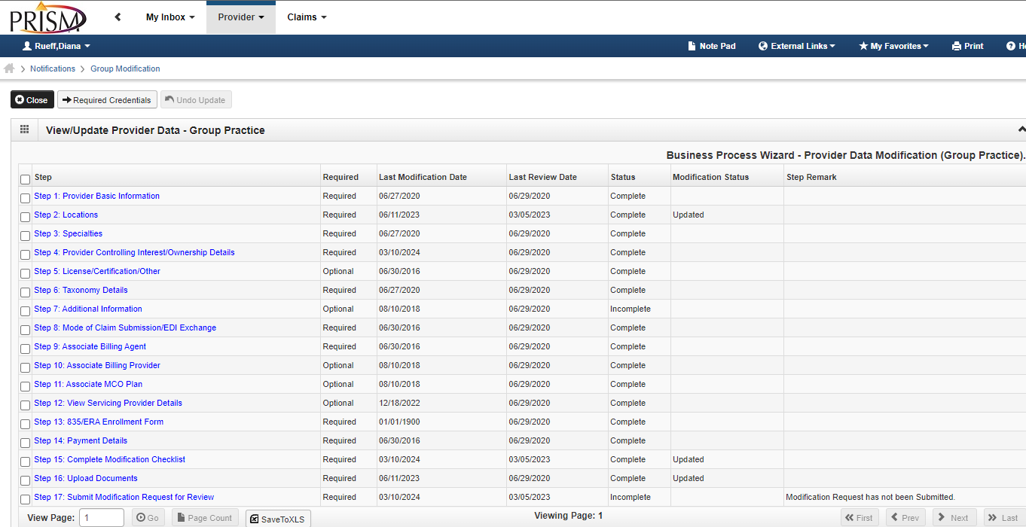
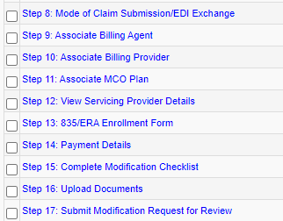

Slide 16
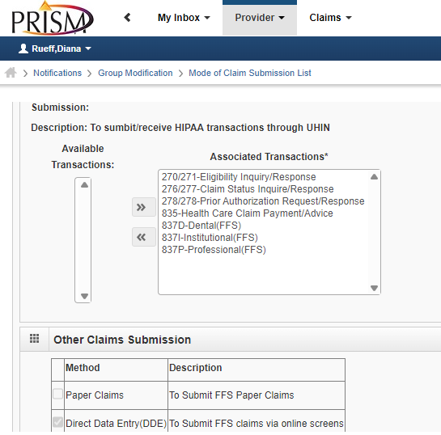
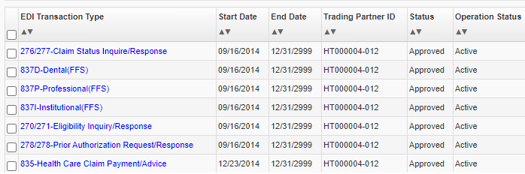
Step 8: Transactions moved to the right that you see listed under Associated Transactions are the file types that must be associated to a Trading Partner Number (TPN) in Step 9.
Step 9: Shows the associated transactions to the Trading Partner numbers. Must say Approved and Active.

Slide 17
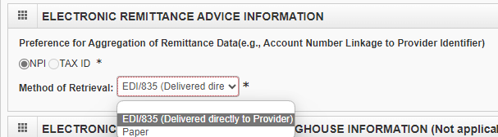
Step 13: Choose how to receive remittance advice from Utah Medicaid either by paper or by EDI/835 (delivered directly to provider).
Pro Tip: Always make sure to do Step 15 and 17 when submitting a Modification in the BPW.

Slide 18
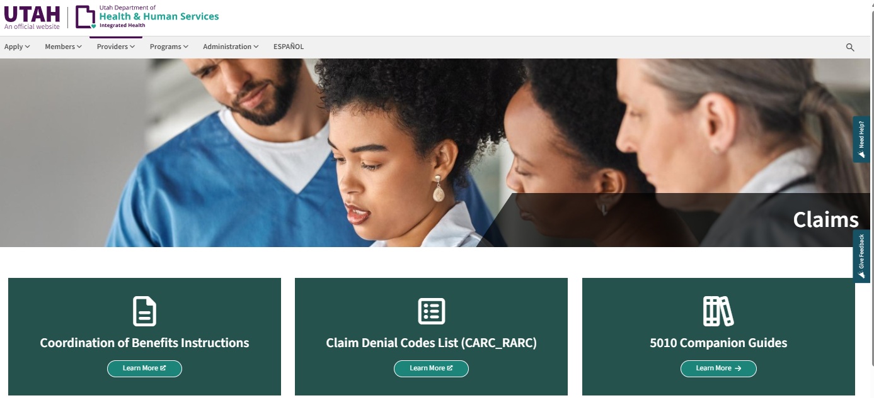
For more information related to transaction submissions review, the 5010 Companion Guides are online:
https://medicaid.utah.gov/claims/ Learn more about Utah Medicaid specific requirements, such as the Trading Partner Number to be submitted in the 1000A Submitter loop segment information and more.
For all questions regarding EDI file issues or EDI enrollment, call us at 801-538-6155 or 1-800-662-9651 (option 3 and then option 5).

Slide 19
Medical notes and hearing guidelines

Slide 20
Documentation submissions
Documentation required for consent forms and wheelchair evaluations, manual review, Emergency Only Program, provider preventable conditions, and timely filing must be uploaded to the Document Management Portal.
  If it is sent via mail, it will not be reviewed and will be discarded.
  Documentation will only be accepted via fax in emergencies. Medicaid staff are not able to move documentation from one queue to another nor from one TCN to another.
Please refer to the Document Management Portal Quick Reference Guide for Providers for instructions on how to upload documents at: https://medicaid.utah.gov/wp-content/uploads/2023/04/DMPquickReferenceGuideProviders.pdf

Slide 21
Documentation submission limits
Direct uploads:
When submitting documentation for Manual Review, Emergency Services Program for Non-Citizens, Sterilization Consent Forms, Timely Filing, Provider Preventable Conditions, etc:
  Submit ONLY the minimum necessary documentation for review of the requested claim/episode of care.
  Please note that primary EOB’s are no longer accepted or necessary to submit.
  Ensure that the TPL is reported correctly on your claim submission.

Slide 22
Manual review correspondence
Beginning July 2024, providers can view letters of decision regarding members claims that have been reviewed by either Manual Review or the Emergency Only Program for non-citizens. A notification will be sent to you when a new letter is available to view. Only providers with the following profiles will be able to view the letters and receive notification: Claims Submitter – Provider, Claims Inquiry – Provider, Claims Processor – Provider, or EXT Provider Account Administrator.
To view the letters, follow these steps:
  My Inbox
    Archived Documents
      PEGA Correspondence Out
        Filter By:
          Medicaid Member ID Number
          Case Number
          Received Date
          Document Title
          NPI
          Date of Service
Status
Program
TCN
Beneficiary First Name
Beneficiary Last Name
Scan Date

Slide 23
Record keeping
Providers are required to maintain accurate clinical records and are subject to audits in which findings could result in the recoupment of payment from the provider. It is the provider’s responsibility to maintain accurate clinical records, including:
Progress notes applicable to the date of service.
Each individual's plan of care, maintained and updated.
Document specific tasks performed on date of service.
Document services billed (number of units billed should support units documented).
Record of physician's order.
Submit record keeping documentation, as requested by the department or under the direction of an audit.
Refer to Section I: General Information, Chapter 4, on the Utah Medicaid website: https://medicaid.utah.gov/Documents/pdfs/SECTION1.pdf

Slide 24
Hearings and appeals
States are required to have a fair hearing system that complies with the provisions of 42 CFR 431, Subpart E. The Department’s administrative hearing procedures are described in Utah Administrative Code R410-14.
A provider can request a hearing to challenge an action. An action is defined as:
  A denial, termination, suspension, or reduction of medical assistance for a recipient.
  A reduction, denial or revocation of reimbursement for services for a provider.
  A denial or termination of eligibility for participation as a provider.
  A determination by skilled nursing facilities and nursing facilities to transfer or discharge residents.
  An adverse determination, meaning a determination made that the individual does not require the level of services provided by a nursing facility or that the individual does not require specialized services.
  An adverse benefit determination made by an MCE (see next slide).
The purpose of the fair hearing will be to determine whether the action taken was in accordance with Medicaid policy. Requests for a hearing, other than those challenging an adverse benefit determination made by an MCE, must be filed within 30 calendar days of the date the Department sent the provider notice of its intended action.
A Request for Hearing Forms can be found on the Department’s website.

Slide 25
Hearings and appeals
MCEs are required by federal regulations to have a grievance and appeals system.
Appeals of adverse benefit determinations: An appeal is a review by an MCE of an adverse benefit determination (ABD). ABDs include, but are not limited to, MCE’s denying payment in whole or part, denying or limiting authorization of a requested service, etc.
If an MCE makes an ABD, the MCE must send notice of the ABD explaining how to request an appeal of the ABD. An appeal request must be filed with the MCE within 60 calendar days from the date on the notice of the ABD.
If the MCE’s appeal decision is adverse, a State Fair Hearing with the Medicaid agency may be requested. A hearing must be requested within 120 calendar days from the date of the MCE’s notice of ABD resolution.
Grievances: A grievance is an expression of dissatisfaction about any matter other than an ABD. Grievances may include, but are not limited to the quality of care or services provided by the MCE, rudeness of MCE providers or employees, failure to respect Medicaid member’s rights, etc.
Grievances may be filed with the MCE at any time.
MCEs must address the grievance within 90 calendar days from the date the MCE receives the grievance.

Slide 26
Timely filing
Time limit to submit a Medicaid claim is 365 days from the date of service per federal regulations.
  For institutional claims, the 365 days begins on the end date of the claim.
  Any adjustments or corrections must also be received within the 365-day time period.
Requesting review of claim that exceeds billing deadline.
  Claims received by Medicaid after the billing deadline will be denied.
  Providers may request to correct a claim outside of the timely filing deadline; however, no additional funds will be reimbursed.

Slide 27
Timely filing
If Medicaid denied a claim for exceeding the billing deadline, the provider may request a review for payment. The situations below may be considered for review, provided specific, appropriate documentation is submitted.
  Provider is under investigation for fraud or abuse.
  Court order.
  Situations involving a provider who conforms with Medicaid requirements by billing a third-party payer first, resulting in non-payment after the 365-day billing deadline, have been allowed as an exception to the filing deadline in hearing decision numbers 13-078-02 and 13-239-03. In accordance with 42 CFR §447.45(d)(4)(iv) and the above paragraph, if a provider files a claim beyond the 365-day limit in such a situation, it is a “same situation” as to prior agency hearing decisions and may be processed.
  Situations involving agency error in processing a timely clean claim resulting in the provider having to again file the claims beyond the one-year deadline have been allowed as an exception to the filing deadline in hearing decision numbers 13-212-08 and 13-212-22. In accordance with 42 CFR §447.45(d)(4)(iv) and paragraph 2 above, if a provider files a claim in such a situation, it is a “same situation” as to prior agency hearing decisions and may be processed.

Slide 28
Clean claim vs new claim
The definitions of the terms “clean claim” and “new claim” affect which claims and adjustments Medicaid may consider for payment when more than 365 days have passed since the date of service.
  Clean claim - Federal regulations define a clean claim as a claim that Medicaid can process without obtaining additional information from the provider of the service or from a third party, including a claim with errors originating in a state’s claim system. A claim that is denied for omitted or incorrect date or for missing attachment is not a clean claim. A claim filed more than 365 days after the date of service is not a clean claim.
  New claim - A new claim is a claim that is unique, differing from all other claims in at least one material fact. It is important to note that identical claims received by Medicaid on different days differ in the material fact of their receipt date and are both new claims unless defined otherwise.

Slide 29
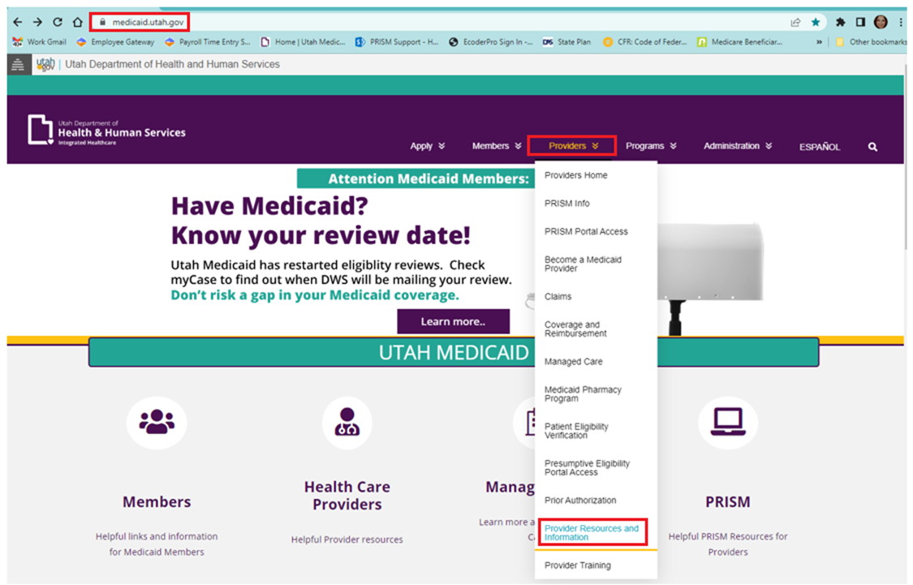
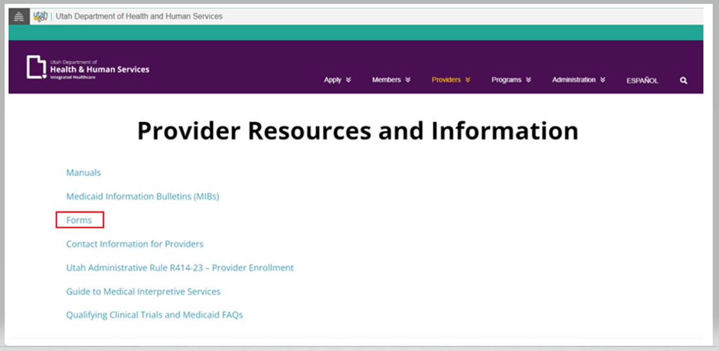
Requesting a fair hearing

Slide 30
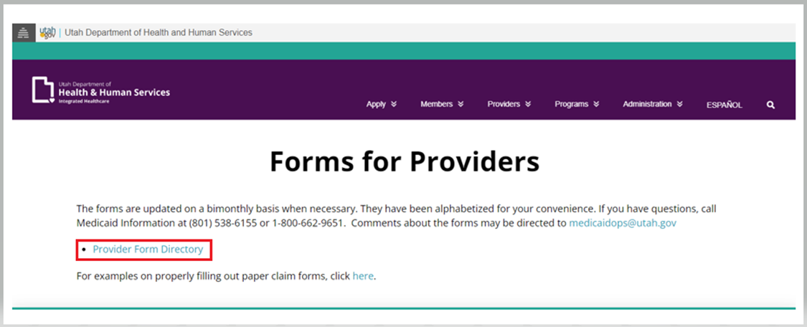
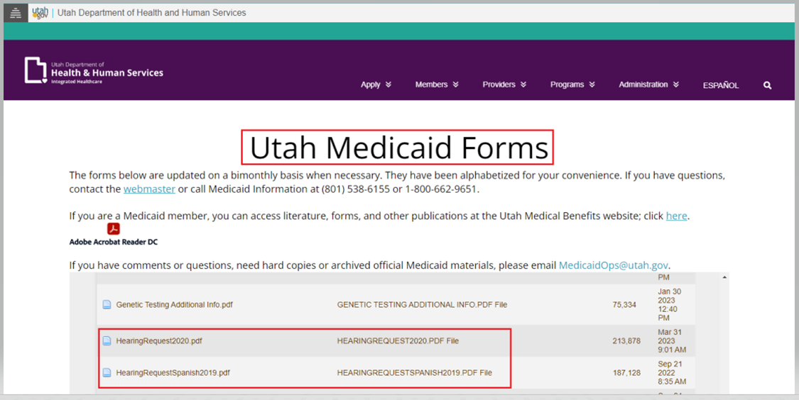
Requesting a fair hearing

Slide 31
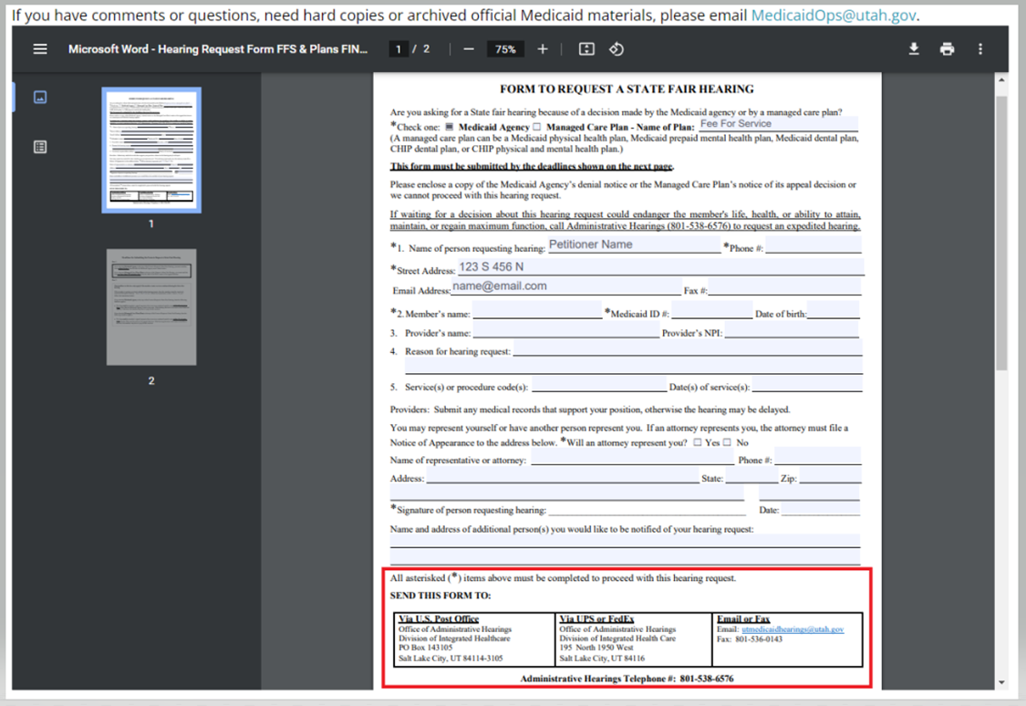
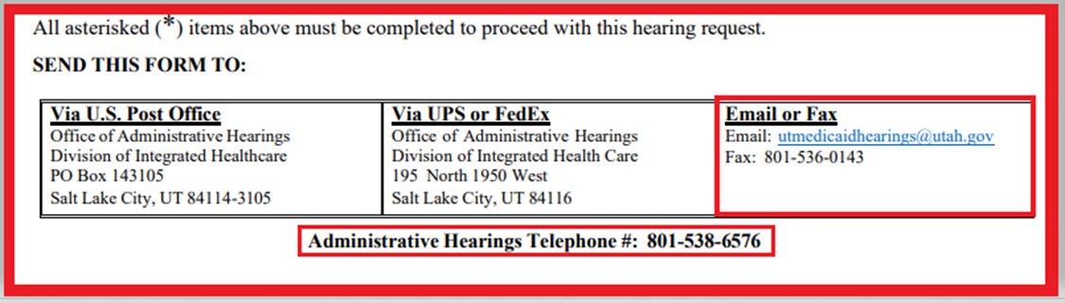
Requesting a fair hearing
This form can be filled out online and saved to your computer. Please complete all of the fields marked with an asterisk symbol (*) and include all required documentation.
For hearing updates, you can contact the hearings office or send an email requesting an update.

Slide 32
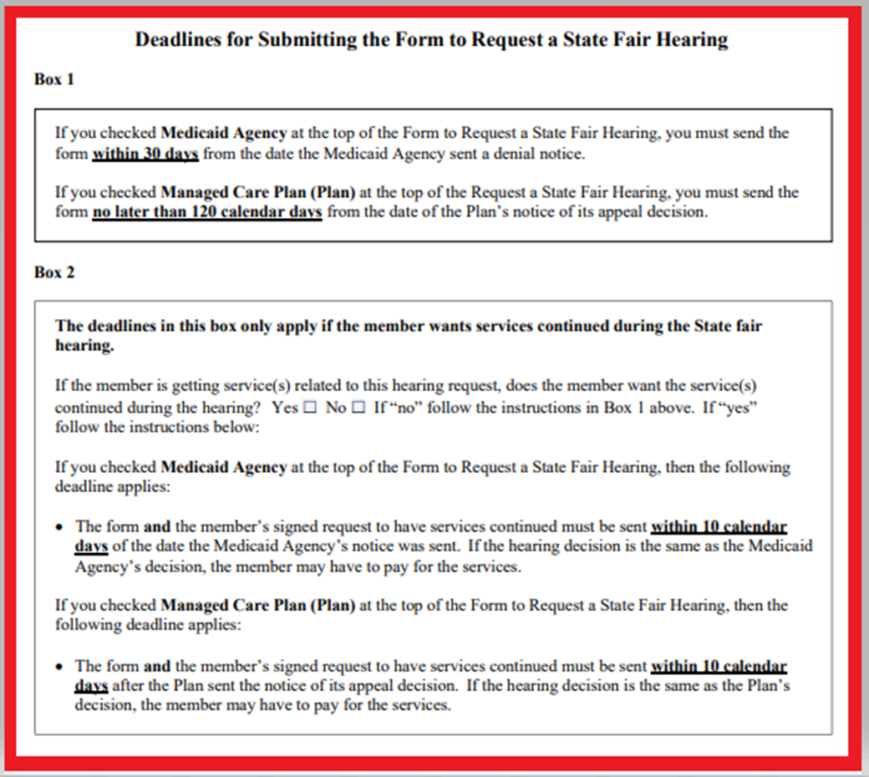
Requesting a fair hearing

Slide 33
Claims inquiry

Slide 34
Claim status inquiry
Inquire claims allow providers to view details of selected claims.
https://prism.health.utah.gov/
Enrolled providers can access PRISM to view their claims, however, only the claims they have submitted, or which have been submitted on their behalf can be viewed.
To inquire on a claim, on the Claims menu, under INQUIRE CLAIMS, click ‘Inquire Claims-Provider’.
The search pages in PRISM have several Filter By drop-downs and corresponding search fields.
  For example, you can search by the TCN (Transaction Control Number), Beneficiary ID/Recipient ID (both options are the same), Patient Account Number (the number the provider used on the claim), Billing Provider NPI, and From/To Dates.
You can save your filter combinations for later use.
  Save only the dropdown options and leave the criteria boxes empty.
  Enter your search option dropdowns and click the Save Filters button.
  Name your filter and add an optional description.
  When you return to this search page, the new filter will appear in the My Filters drop-down.
  Selecting a filter will pre-populate search option dropdowns that you might use frequently in your business area.
PRISM has a ‘wild card’ option for fields that are unknown or can vary, like the rendering provider NPI
  The ‘wild card’ key is the, % (percent) key.
  Please be aware the ‘wild card’ key (%) does not work for a few search criteria like date spans or beneficiary ID numbers, for example.

Slide 35
Adding Third Party Liability and Coordination of Benefits

Slide 36
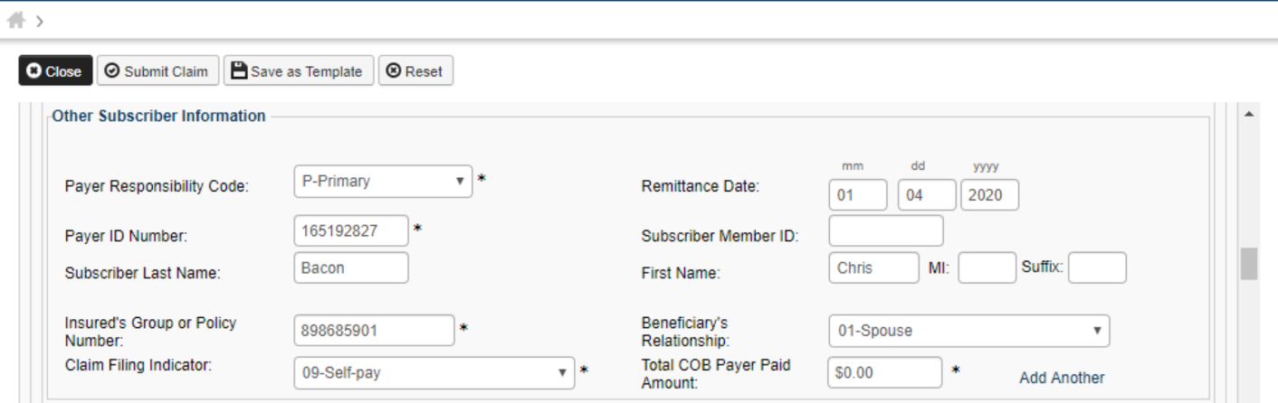
Adding TPL at the header level
The Header TPL information below is required.
Please note the total Coordination of Benefits paid amount.

Slide 37
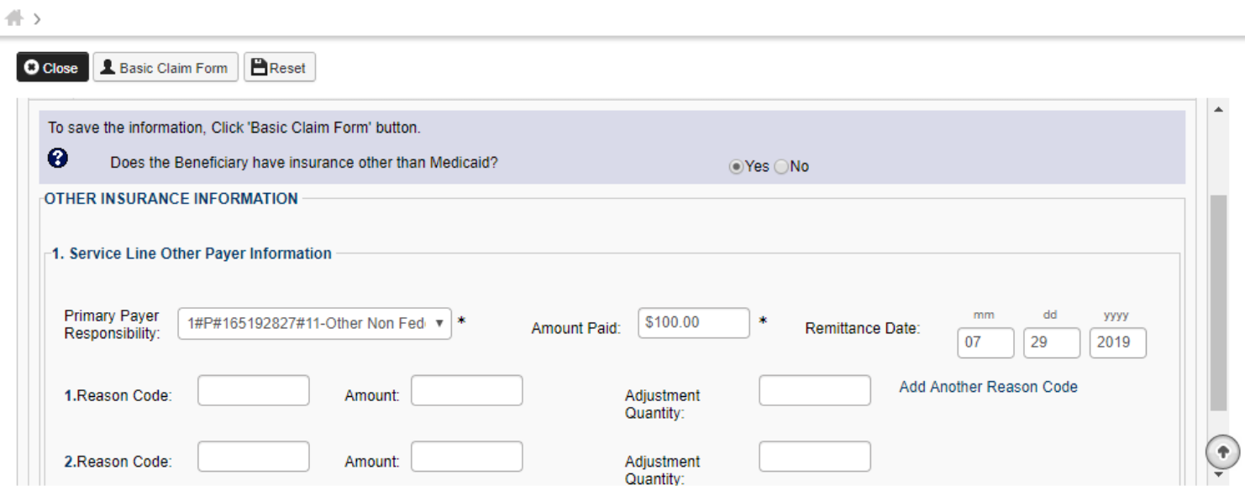
Adding TPL at the service line level
The service line TPL information below is required.
All of the service line TPL amounts must equal the COB amount at the header level TPL.

Slide 38
Coordination of Benefits
Before submitting a claim to Medicaid, a provider must submit and secure payment from all other liable parties such as Medicare Part A and B.
  For more information, refer to the Medicaid General Information Section 1, Chapter 11.
Claims denied as non-covered services by Medicare should be submitted to Medicaid Fee for Service, not as a crossover claim.

Slide 39
Claim submission options

Slide 40
Options to submit claims
Claims can be submitted through your preferred clearinghouse.
Batch claims can be electronically submitted by the provider’s office with HIPAA compliance x12 capability.
Claims can be entered directly into PRISM via Direct Data Entry (DDE).
  Please refer to the eLearnings at: https://medicaid.utah.gov/prism-provider-training/
  Batch submissions are not available for Direct Data Entry.

Slide 41
Corrected claims
Providers should submit their own corrections to claims less than three years old by submitting a Adjust/Void in PRISM.
  Paid claims that need to be corrected or adjusted:
    Use the Adjust/Void feature to submit corrected or adjusted claims.
  Denied claims that need to be corrected or adjusted:
    Submit a new claim.

Slide 42
SPOTs
https://medicaid.utah.gov/prism-faq/
  PRISM release notes
    Completed SPOTS
  Future proposed PRISM release notes
    In progress SPOTS
SPOTs are:
Change requests
System defects
Future enhancements

Slide 43
Publications

Slide 44
Provider resources
https://medicaid.utah.gov/provider-resources-and-information/
  Utah Medicaid provider manuals
  Medicaid Information Bulletins (MIBs)
  Provider manuals and MIBs are a great way to stay up to date with policy changes, outages, and updates.
  MIBs are bi-monthly with special interim publications in the event of important updates or emergencies.

Slide 45

Contact us
Please email us at:
providertrainingsupport@utah.gov

